Slide 1
Lecture 6
Method to Fulfill the Basic Human Aspirations

Slide 2
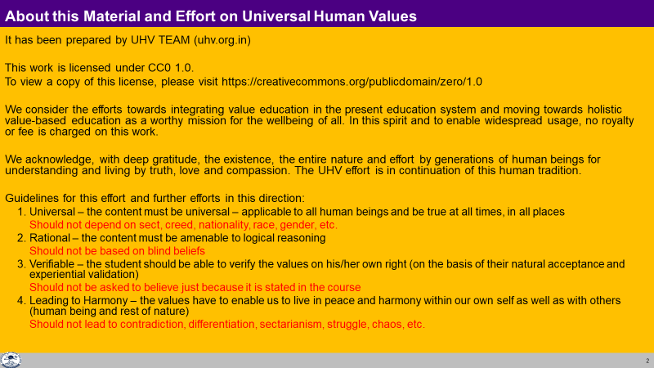

Slide 3
Human Being Living with Human Consciousness
RIGHT UNDERSTANDING
(le>)
in the self
Understanding Harmony
Understanding Harmony:
Harmony in Human Being
Harmony in Family
Harmony in Society
Harmony in Nature/Existence
Education –
Understanding
1
RELATIONSHIP (laca/k)
with human being
PHYSICAL FACILITY
(lqfo/kk)
with rest of nature
Living in Harmony
2
3
Living in Harmony
at all levels of being:
Individual (Human Being)
Family
Society
Nature/Existence
Sanskar – Living
MUTUAL HAPPINESS
(mHk; lq[k)
MUTUAL PROSPERITY
(mHk; le`f))

Slide 4
Happiness Continuity of Happiness
The state or situation, in which I live,
if there is harmony / synergy in it,
then it is Naturally Acceptable to me to be in that state / situation
(and I want to continue to be in that state / situation)
To be in a state / situation which is Naturally Acceptable is Happiness
To be in a state of Harmony / Synergy is Happiness
Happiness = To be in Harmony
State / Situation in which I live
or expanse of my being:
  As an Individual Human Being
  As a member of a Family
  As a member of Society
  As an unit in Nature/Existence
Continuity of Happiness
= Harmony at all levels of being i.e.
  Harmony in the Human Being
  Harmony in the Family
  Harmony in the Society
  Harmony in Nature/Existence

Slide 5
Our Program
To facilitate understanding of the harmony at all levels of being
  Harmony in the Human Being
  Harmony in the Family
  Harmony in the Society
  Harmony in Nature/Existence
To understand harmony and to live in harmony at all levels of being
  In the Human Being
  In the Family
  In the Society
  In Nature/Existence
Proposals
1
Verify the proposals
on the basis of your NATURAL ACCEPTANCE
b) Experiential validation
by LIVING ACCORDINGLY
2
Right Understanding
Right Feeling

Slide 6
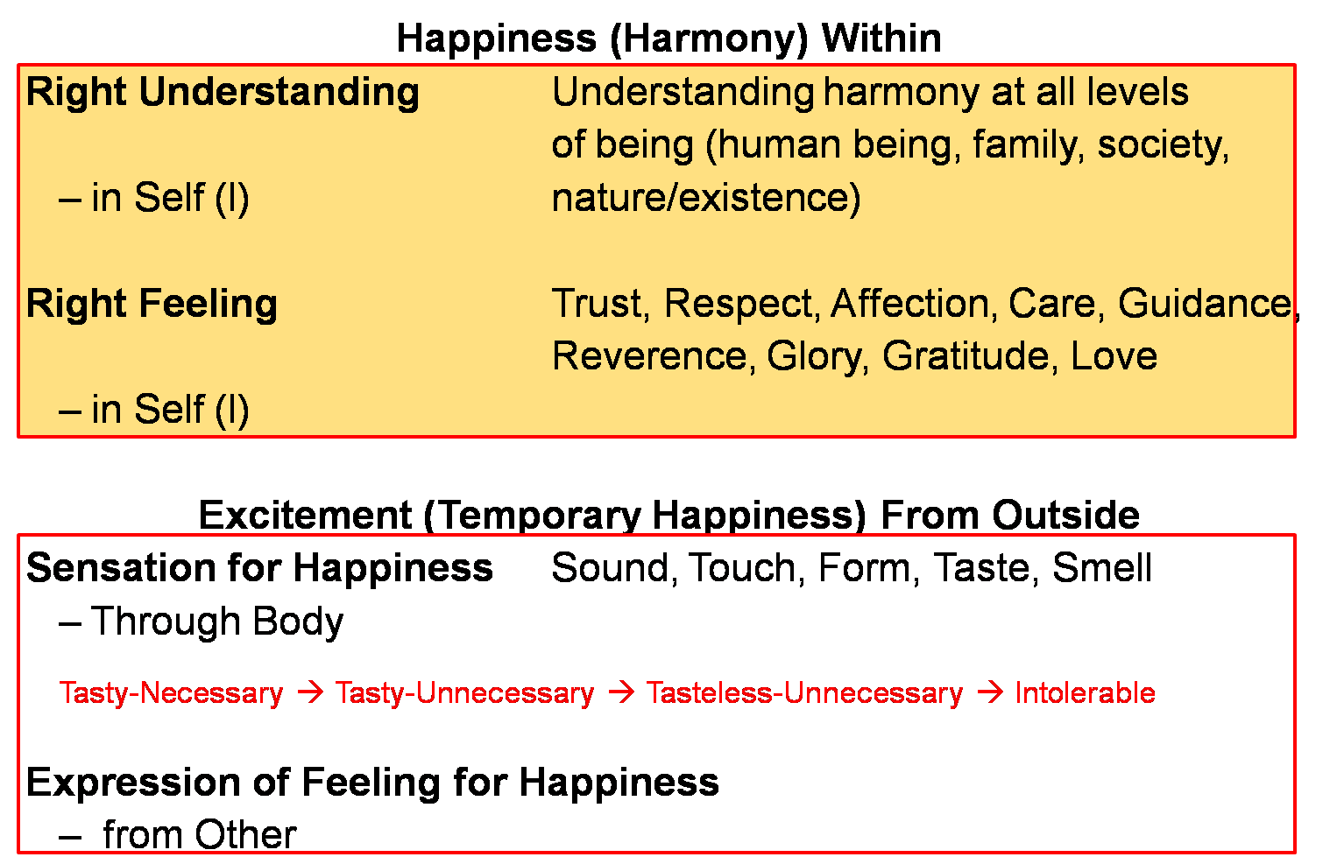
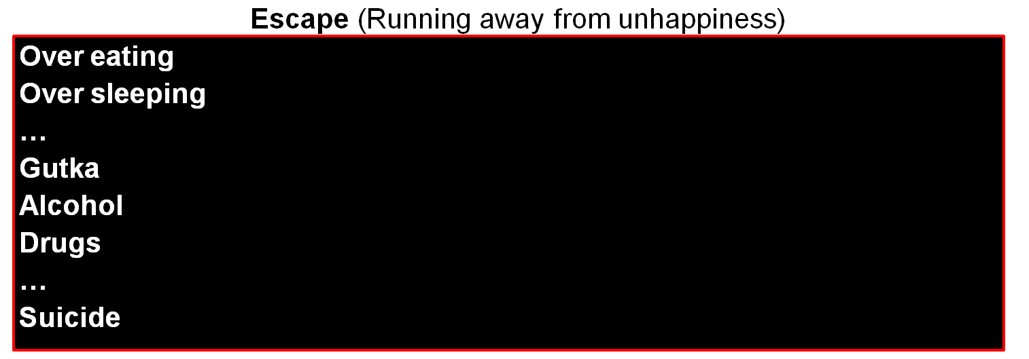
Continuous happiness
Realised
(Dorji)
Human Consciousness
--------------------------------------------------------------------- Transformation / Development -----------------------------------------
Temporary excitement
Recovering
Addict
Animal Consciousness
Temporary escape from unhappiness
Addict

Slide 8
Key Points
Method to Fulfill the Basic Human Aspirations

Slide 9
Human Being Living with Human Consciousness
RIGHT UNDERSTANDING
(le>)
in the self
Understanding Harmony
Understanding Harmony:
Harmony in Human Being
Harmony in Family
Harmony in Society
Harmony in Nature/Existence
Education –
Understanding
1
RELATIONSHIP (laca/k)
with human being
PHYSICAL FACILITY
(lqfo/kk)
with rest of nature
Living in Harmony
2
3
Living in Harmony
at all levels of being:
Individual (Human Being)
Family
Society
Nature/Existence
Sanskar – Living
MUTUAL HAPPINESS
(mHk; lq[k)
MUTUAL PROSPERITY
(mHk; le`f))

Slide 10
Happiness Continuity of Happiness
The state or situation, in which I live,
if there is harmony / synergy in it,
then it is Naturally Acceptable to me to be in that state / situation
(and I want to continue to be in that state / situation)
To be in a state / situation which is Naturally Acceptable is Happiness
To be in a state of Harmony / Synergy is Happiness
Happiness = To be in Harmony
State / Situation in which I live
or expanse of my being:
  As an Individual Human Being
  As a member of a Family
  As a member of Society
  As an unit in Nature/Existence
Continuity of Happiness
= Harmony at all levels of being i.e.
  Harmony in the Human Being
  Harmony in the Family
  Harmony in the Society
  Harmony in Nature/Existence

Slide 11
Our Program
To facilitate understanding of the harmony at all levels of being
  Harmony in the Human Being
  Harmony in the Family
  Harmony in the Society
  Harmony in Nature/Existence
To understand harmony and to live in harmony at all levels of being
  In the Human Being
  In the Family
  In the Society
  In Nature/Existence
Proposals
1
Verify the proposals
on the basis of your NATURAL ACCEPTANCE
b) Experiential validation
by LIVING ACCORDINGLY
2
Right Understanding
Right Feeling

Slide 12
Continuous happiness
Realised
(Dorji)
Human Consciousness
--------------------------------------------------------------------- Transformation / Development -----------------------------------------
Temporary excitement
Recovering
Addict
Animal Consciousness
Temporary escape from unhappiness
Addict

Slide 13
FAQs for Lecture 6
Method to Fulfill the Basic Human Aspirations

Slide 14
Question(s) 1: Four Levels Response
If ensuring harmony at one level disturbs the harmony at some other level, how can I make the program for continuity of happiness?
e.g. taking care of my baby and doing justice with my job
e.g. when I invest myself for right understanding, the family members feel angry on me, and there is disharmony in the family.
As it appears today, to manage things at one level makes it difficult at another level, as mentioned in the examples quoted. However, we are not talking about managing things, we are talking about ensuring harmony. If i am trying to understand harmony and live in harmony at one level, it will certainly help in understanding and living in harmony at other levels, atleast it will not contradict. For example, if I am working for harmony at the individual level, as a human being, I will ensure right understanding and right feeling in the self. This will certainly facilitate my being in harmony at the family level because I can now ensure mutual fulfillment in my behaviour with right feelings. Similarly, I can better participate in ensuring harmony at the level of society and nature.

Slide 15
Balance between profession and persona/family life
Compromise
People are migrating for work
(present day education is inadvertently setting up a world view… this type of mindset that village… working with land etc. is not OK, a curse…
3 generations living together
Getting uprooted migrating from village to city to big city to US Canada etc.
Empty houses, empty villages, fallow land… a disturbed society (crowd)
Compromised social base / family/social security… losing out on family… community… culture… for some type of work
Used to have production at home… in the village…

Slide 16
Question(s) 1: Four Levels Response
Few people in the history have said that the biggest hurdle in the development of society is family. They propounded the concept of commune. Where do we place the commune here?
There have been two experiments tried out in the history-
One says that family is a hurdle in the development of the society, therefore, get rid of the family,
the other says that family is a hurdle in the development of the individual, therefore, get rid of the family,
What we are saying is that if harmony in the family is understood properly and ensured, then family will provide the appropriate environment including education- sanskar for the development of the individual; and it will also work as the basic building block for development of the society.
In fact, what they visualised as commune was essentially a version of harmonious family of a bigger size..

Slide 17
Question(s) 2: Four Levels Response
If there is disharmony in the society, I will also be in disharmony as I am part of society. Then how can I ensure happiness in continuity? Similar with nature.
If there is harmony in the society, then certainly it will provide appropriate environment including education- sanskar for my development. However, even if this is not there, it is possible for me to work for self-development through sef-exploration and if I ensure this, then I can be in a state of harmony within and happiness within in continuity. In fact, i will even became a help in the process of development of harmony in the society. But, this is going to be a much more difficult task for me than in case there is harmony in the society.

Slide 18
Question(s) 3: Four Levels Response
How do I demarcate between family and society? e.g. my in-laws, extended family members, neighbors, friends, etc.
I have a pet, and I treat it like a family member. Is it fine to do it as it is not a human being?
The range of family is from family (blood-relation) to world family. What matters really is my feeling of relationship (and my competence for its fulfillment), how extended it is i.e. how many people I feel related to; that will define the size of the family. Atleast we should be able to have this feeling of relationship for the members of the family (blood-relation) with three generations.
It is fine to do it with animals too, but we must be able to do this human being as well. It should not happen that we are not able to do it for human beings in the family and we are using the pet as a substitute.

Slide 19
Question(s) 4: Four Levels Response
Where do I put my organization or place of work here? In family or society?
Why have we put nature and existence together at the fourth level?
If I have the feeling of relationship and competence for its fulfillment with all the members of the organisation, I will take it as a family. Otherwise I have to place it in the society, if there is a common goal; if there is a no common goal, it will be more like a crowd than society.
When it comes to fulfillment, we have to work with nature only. At the level of existence, we only have to understand the existence as co-existence, we do not have to do anything for it, it is ever-present anyway.

Slide 20
Question(s) 5: Four Levels Response
How can I be in harmony with the entire nature/existence? I don’t even know so many things in the nature/existence.
We have to understand that there is harmony at the level of nature and existence and we have to have that feeling of harmony for every unit in nature. That is what is important. When it comes to fulfillment, we will get the necessary information about the concerned unit as and when required.

